Slide 1
Runbook Figures

Slide 2
RAN LLD
Strategic Plan & Scope
High Level Network Architecture
Network Design
Deployment
Operations & Maintenance
Field Maintenance
Post-Launch Engineering
Supply Chain Management
Strategy
Business Rules
Service Requirements
Engineering Specifications
Approved Equipment
Site Survey data
Network Design
RAN HLD
RAN LLD
TX Network HLD
TX Network LLD
Civil & Power Design
to Deployment
Mobile Core HLD
Mobile Core LLD
NFVI Dimensioning

Slide 3
RAN LLD
LLD Radio Network Activities
Deliverables
RAN HLD Recommendation
Existing Network Configuration
Master Database
Geodemographic
data layers
Site Configuration Refinement
DataFill
Azimuth, Tilt Definition
Naming Convention Establishment
PCI Planning
Data Fill Generation
Baseline
Coverage, Throughput, SINR & Best Server Plots Generation
Network Parametrization
Neighbor Strategy Definition
Features Parametrization
Bill of Materials
Neighbor Planning Definition
Master Database Update / Generation
Mobility Strategy Definition
RAN LLD Recommendation
Mobility Management Definition
Bill of Materials Generation
Input
Process
Subprocess
Output
Overlay Only

Slide 4
RAN LLD
Capacity Bands
Coverage Bands
Cell Radius
High Frequencies (> 1 GHz)
Low Frequencies (< 1 GHz)
Deployment Scenario
Urban
Sub-urban
Rural
Carrier Bandwidth
20 MHz
10 MHz
5 MHz

Slide 5
RAN LLD
Cell Bandwidth
Center Frequency
Available Spectrum block bandwidth

Slide 6
RAN LLD
Cell Bandwidth
Center
Frequency
Frequency
Available Spectrum block bandwidth

Slide 7
RAN LLD

Slide 8

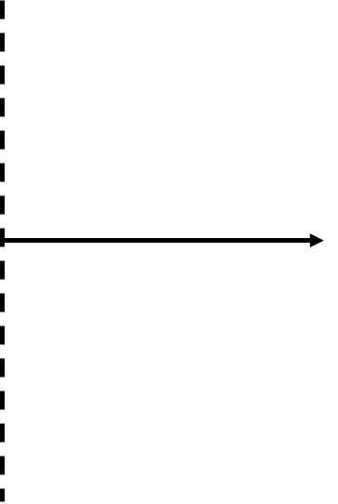
RAN LLD
Phase 1
Phase 2
Phase 3
Phase 4

Slide 9
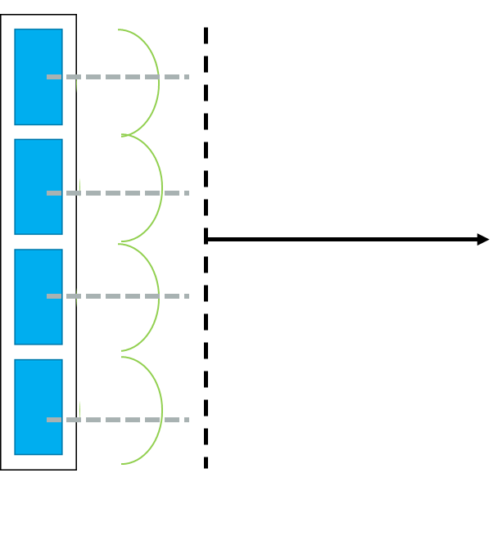
RAN LLD
Phase 1
Phase 1
Phase 1
Phase 1

Slide 10
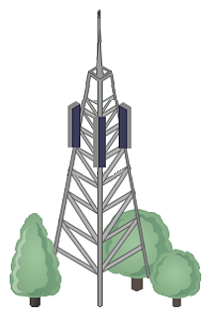
RAN LLD
Antenna Tilt
140°
45°
270°
a)
b)

Slide 11

RAN LLD
Antenna Tilt
0°
h
aBW
A
H
ha
C

Slide 12
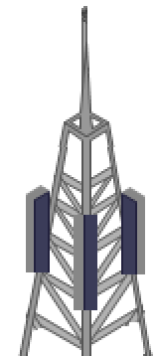
RAN LLD
eNodeB 1
eNodeB 2
eNodeB 3
1
1
1
3
2
2
Cell | Group Number (SSS) | Cell Number (PSS) | PCI
1 | 0 | 0 | 0
Cell | Group Number (SSS) | Cell Number (PSS) | PCI
1 | 1 | 0 | 3
2 | 1 | 1 | 4
3 | 1 | 2 | 5
Cell | Group Number (SSS) | Cell Number (PSS) | PCI
1 | 2 | 0 | 6
2 | 2 | 1 | 7

Slide 13
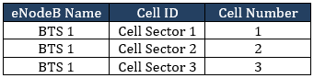
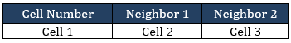
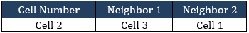
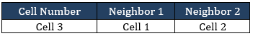
RAN LLD
N
1
3
2
BTS 1
1
1
1
3
2
3
2
3
2

Slide 14
RAN LLD
LTE
3G - UMTS
1
1
1
3
2
3
2
3
2

Slide 15
RAN LLD
LTE Cells
2G – GMS
3G -UMTS

Slide 16
RAN LLD
Site 1
Site 2
1
1
2
Cell | Group Number (SSS) | Cell Number (PSS) | PCI
1 | 0 | 0 | 0
2 | 0 | 1 | 1
Cell | Group Number (SSS) | Cell Number (PSS) | PCI
1 | 1 | 0 | 3

Slide 17
RAN LLD
1
2
Site 1
1
Site 2

Slide 18
RAN LLD
1
1
2
Co-site:
Adjacent:
Cell Number | Neighbor 1
1 | 2
2 | 1
Site Number | Cell Number | Neighbor
 |  | Site Number | Cell Number
2 | 1 | 1 | 2
Adjacent:
Site Number | Cell Number | Neighbor
 |  | Site Number | Cell Number
1 | 2 | 2 | 1

Slide 19
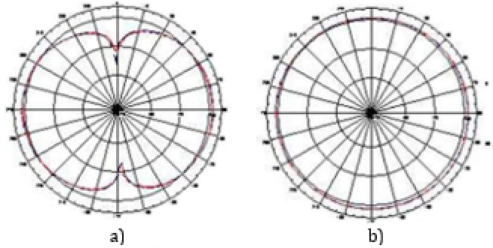
RAN LLD

Slide 20
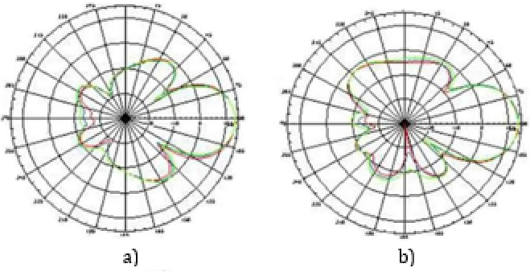
RAN LLD

Slide 21
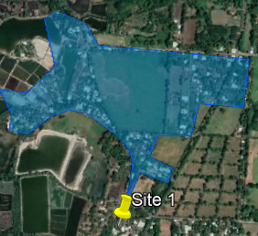
RAN LLD

Slide 22
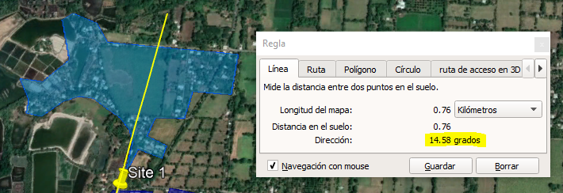
RAN LLD

Slide 23
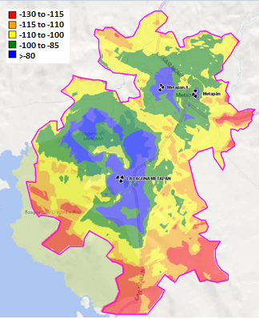
RAN LLD

Slide 24
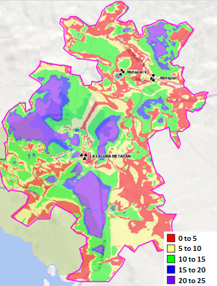
RAN LLD

Slide 25
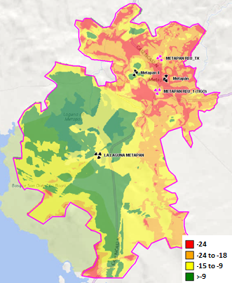
RAN LLD

Slide 26
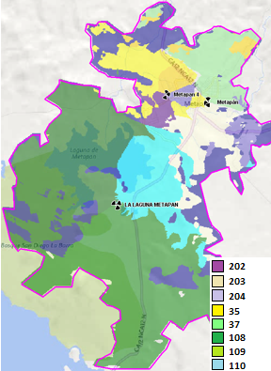
RAN LLD

Slide 27
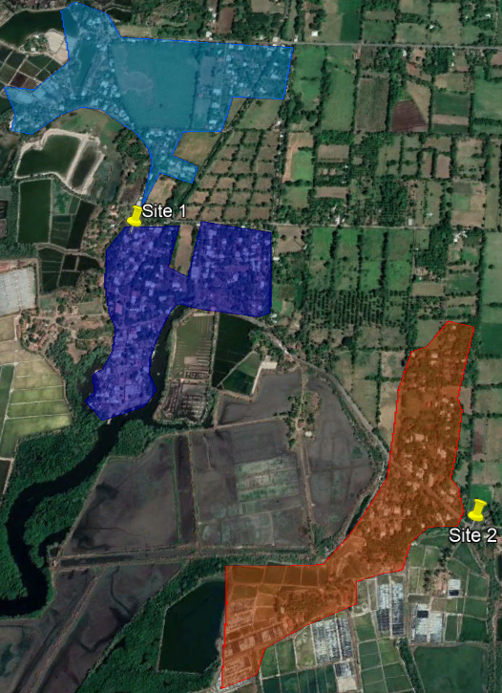
RAN LLD

Slide 28
RAN LLD

Slide 29
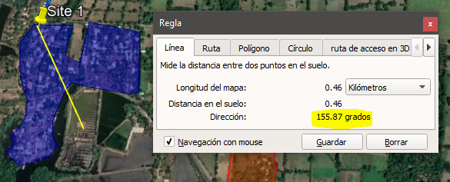
RAN LLD

Slide 30
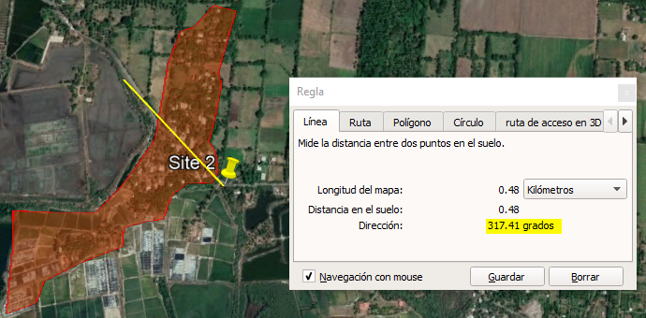
RAN LLD

Slide 31
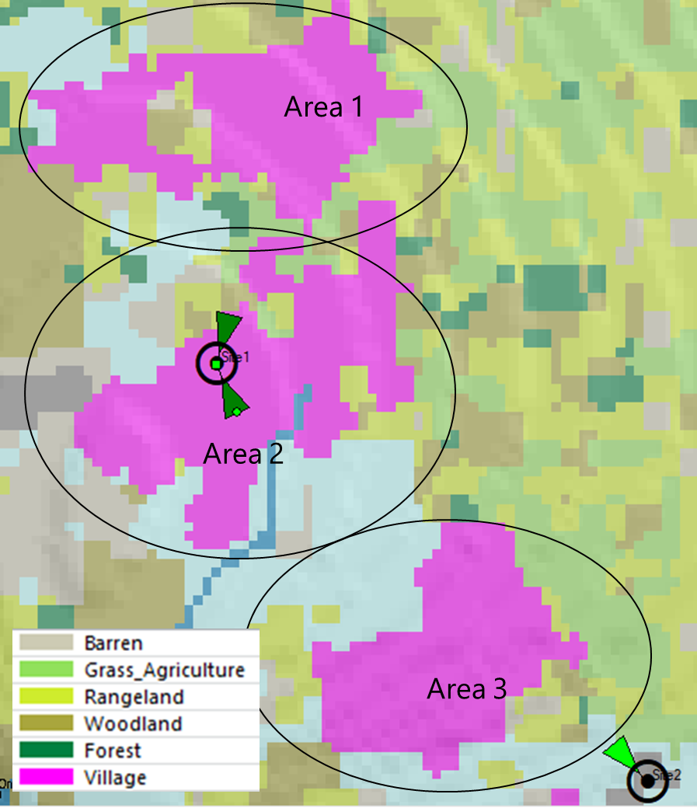
RAN LLD

Slide 32
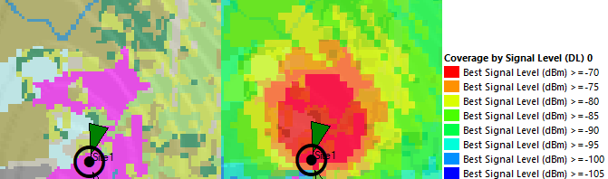
RAN LLD

Slide 33
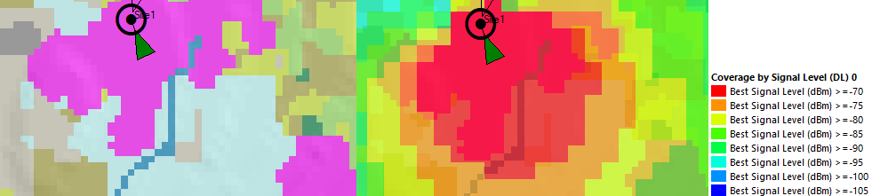
RAN LLD

Slide 34
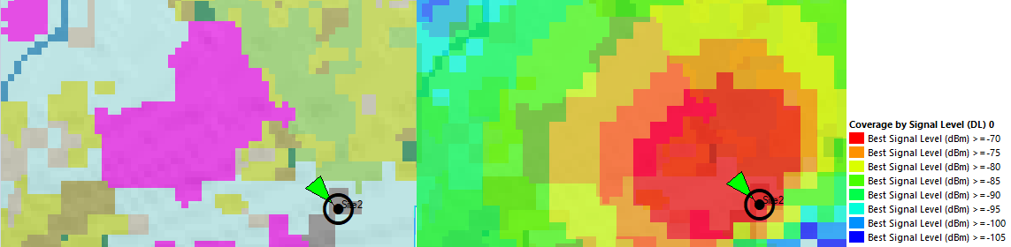
RAN LLD

Slide 35
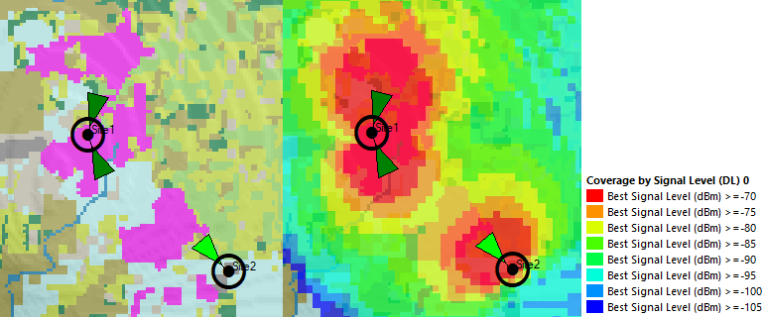
RAN LLD

Slide 36
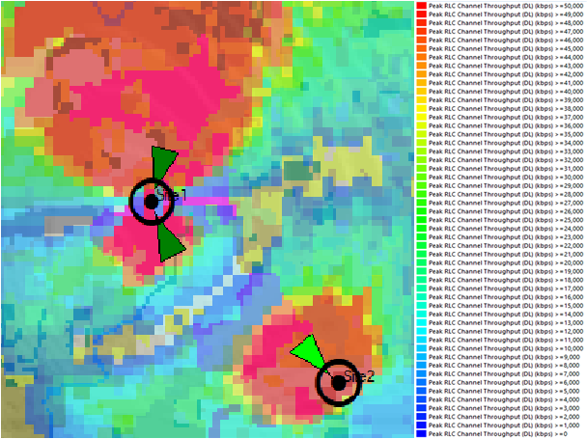
RAN LLD

Slide 37
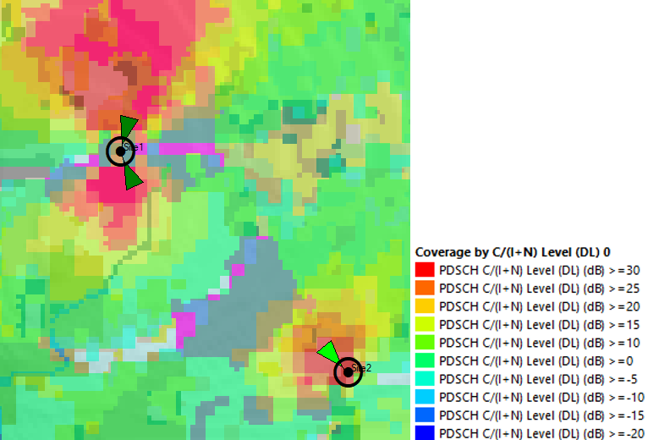
RAN LLD

Slide 38
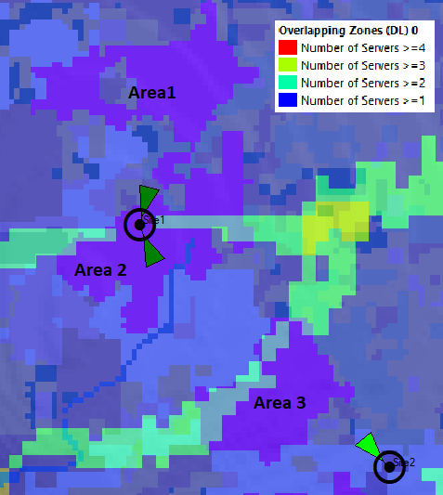
RAN LLD

Slide 39
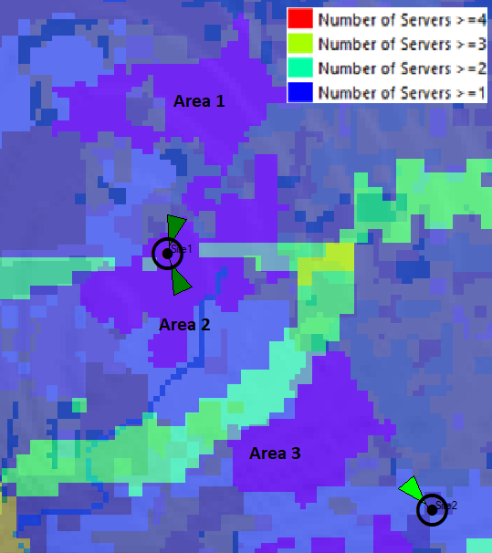
RAN LLD

Slide 40
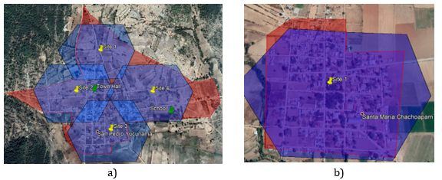
RAN LLD

